Slide 1


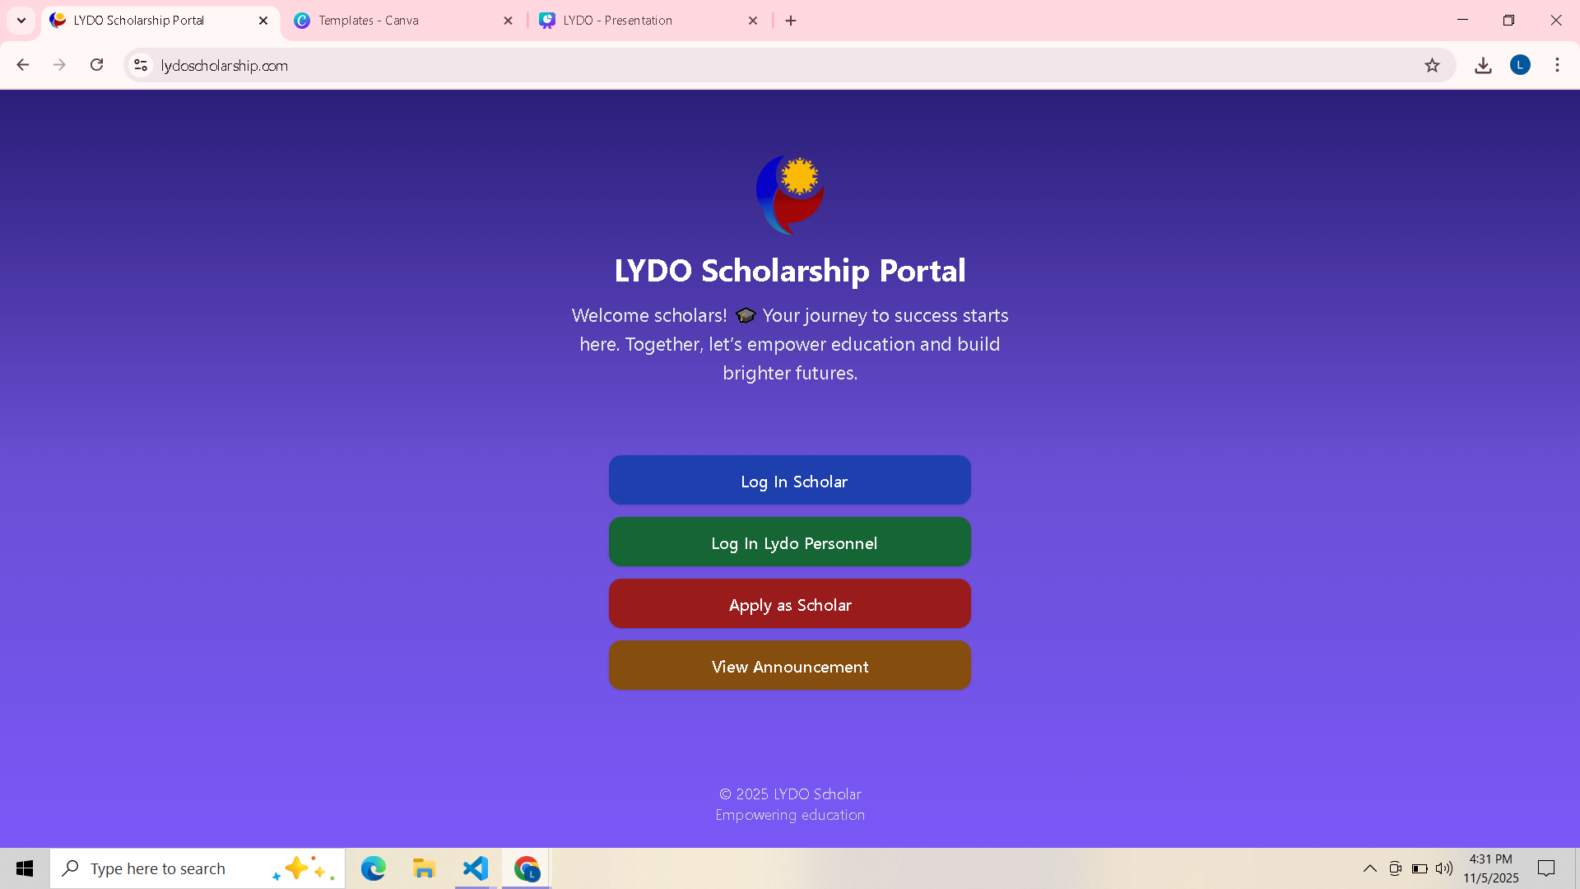

LYDO SCHOLARSHIP
MANAGEMENT SYSTEM
TEAM PRACS

Slide 2


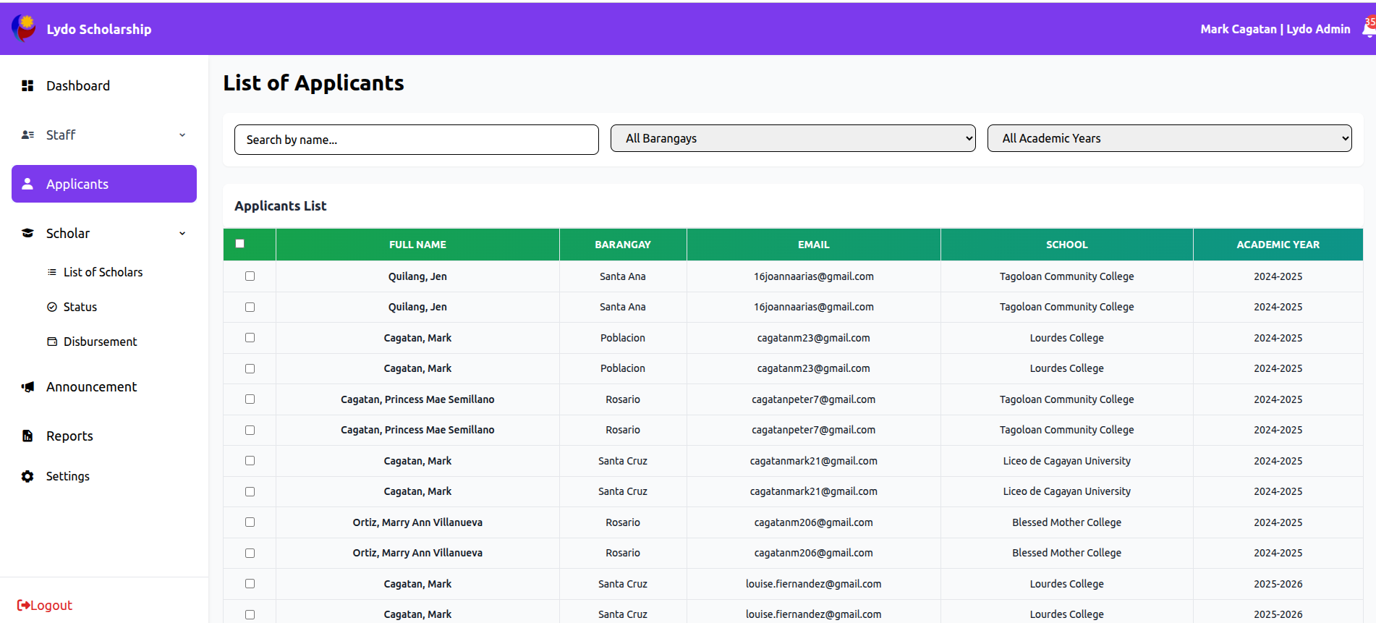
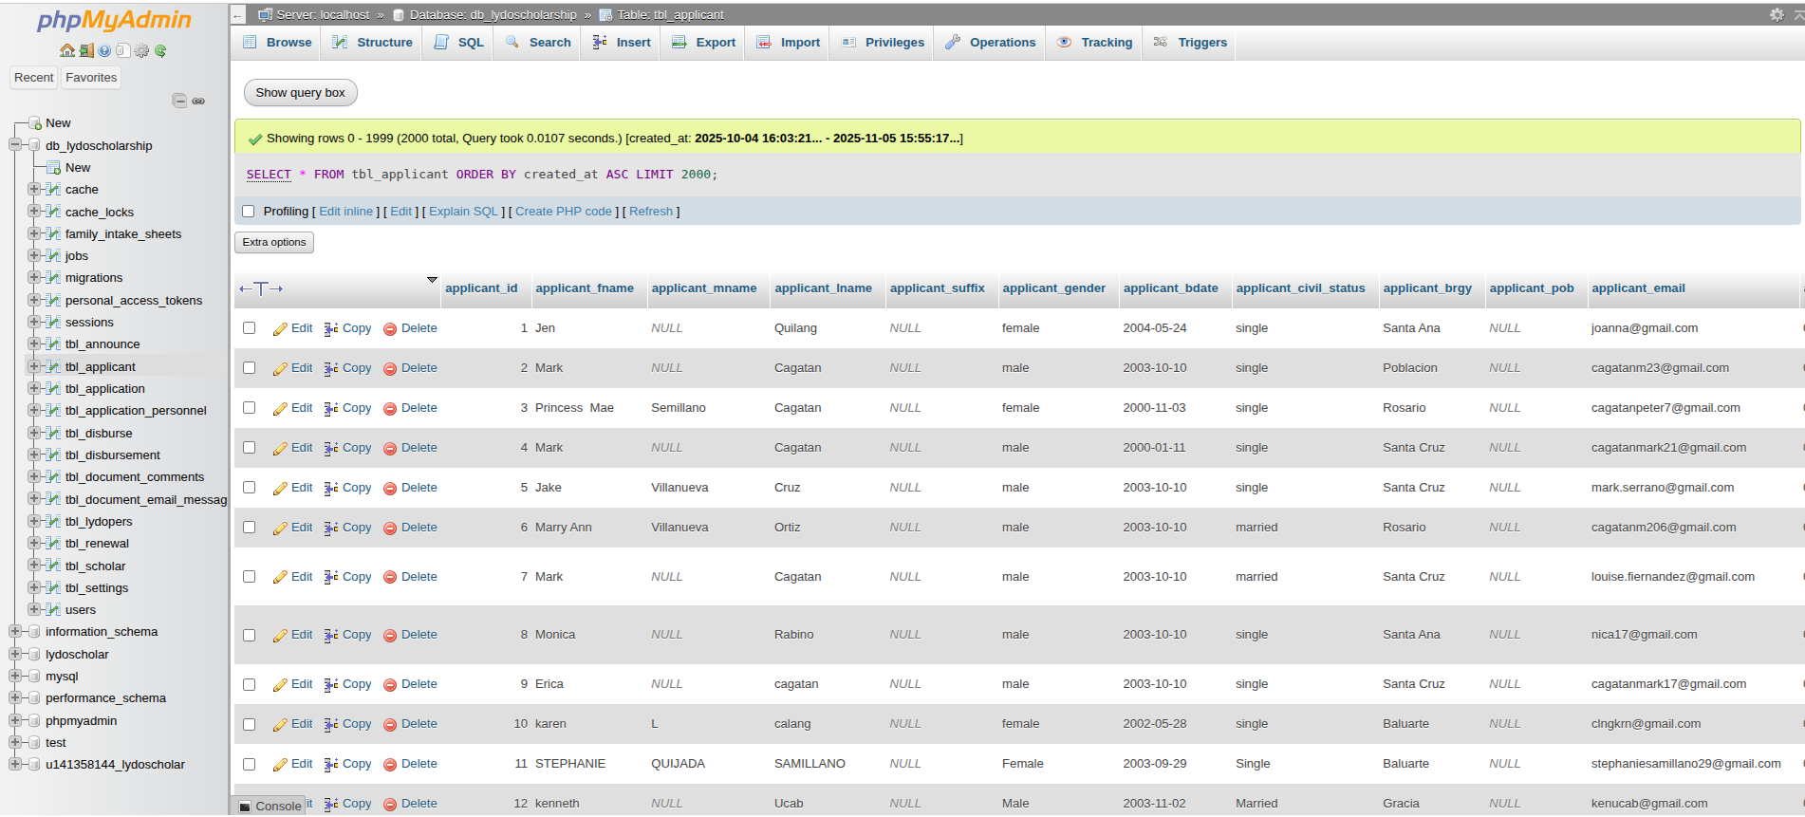
Problem 1: Slowest Query (>100ms) - Overview
LOCATION :
admin staff - applicants - list of applicants
TABLE :
tbl_users
GOAL :
identify the slowest query and to enhance the speed.
BASELINE MEASUREMENT DONE BY PHPMYADMIN USING SQL PROFILING

Slide 3

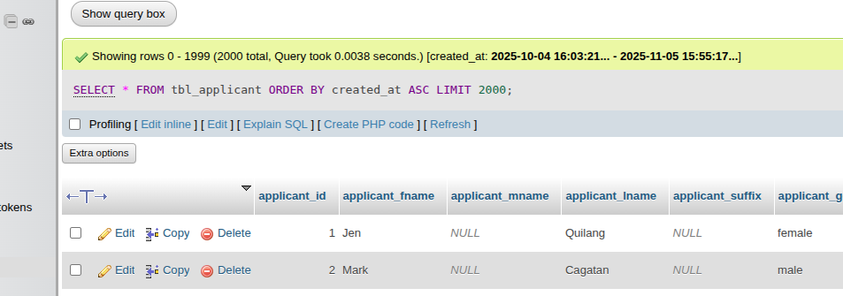
QUERY USED BY :
applicant records list to load all applicants from the database.
MEASURES ( BEFORE ) :
0.0038 seconds in phpMyAdmin
query returns 200 rows from tbl_applicant table
currently fast, but may slow as the table grow larger
THE ORDER BY CREATED_AT ASC OPERATION MAY BECOME SLOWER IF CREATED_ AT IS NOT INDEXED.
Problem 1: Slowest
Query (>100ms)

Slide 4

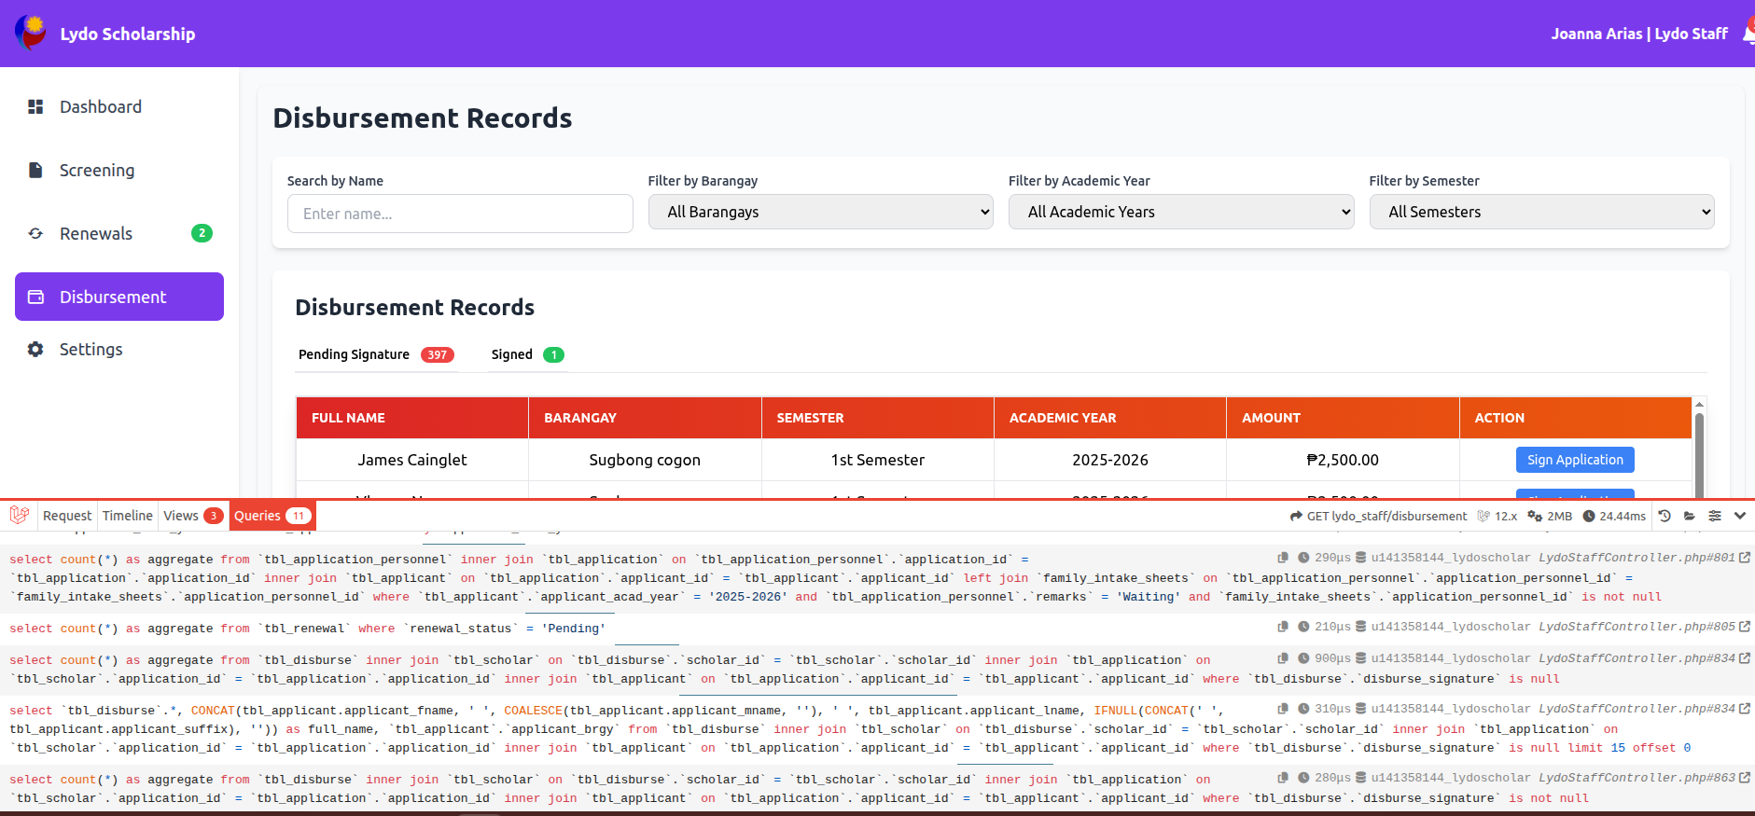
Problem 2: The N+1 Killer (Eager Loading Issue)
DIAGNOSIS :
1 query to load the main disbursement record
1 extra query to load the applicant details
1 extra query to load the barangay information
FOR N ROW, THIS BECOMES
1 ( main query ) + 2N extra - queries
DEBUGBAR SHOW REPEATED SIMILAR QUERIES PER REQUEST :
select * from tbl_applicants where id=?
select * from tbl_barangay where id=?

Slide 5
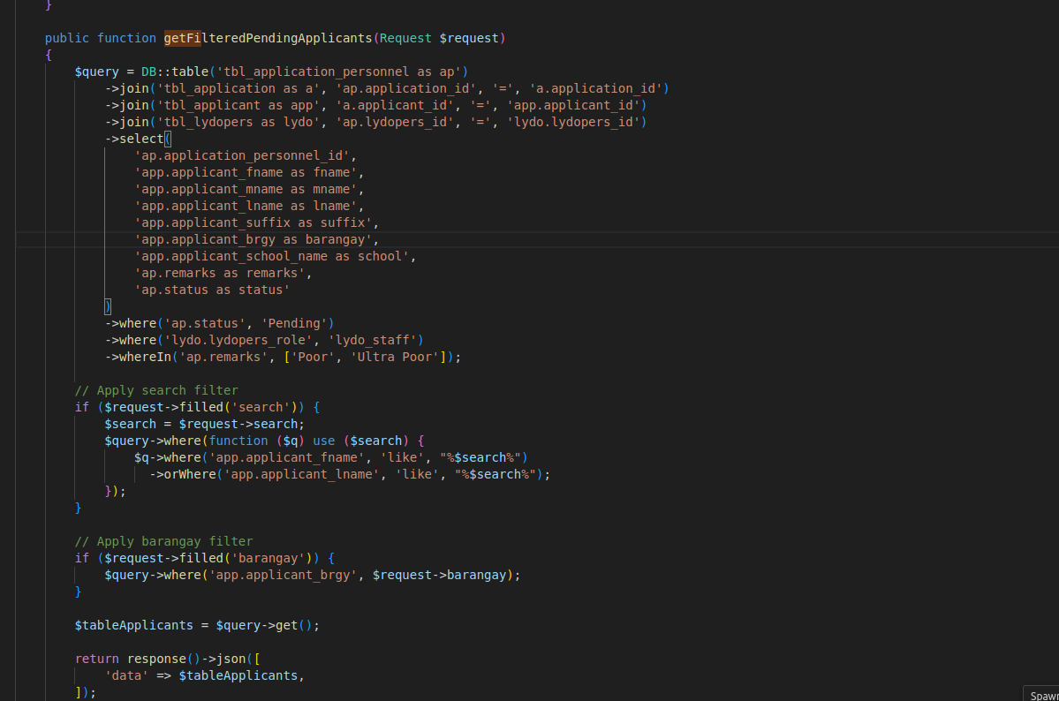

Problem 2: The N+1 Killer (Eager Loading Issue)
DIAGNOSIS :
1 query to load the main applicant record
1 extra query to load barangay details
FOR N ROW, THIS BECOMES
1 ( main query ) + N extra - queries
DEBUGBAR SHOW REPEATED SIMILAR QUERIES PER REQUEST :
select * from tbl_applicants where id=?
select * from tbl_barangay where id=?

Slide 6
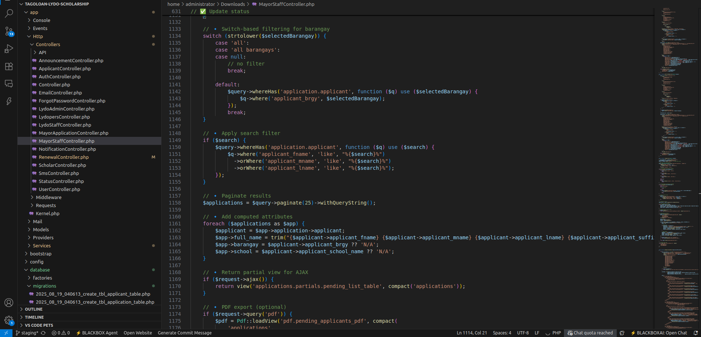

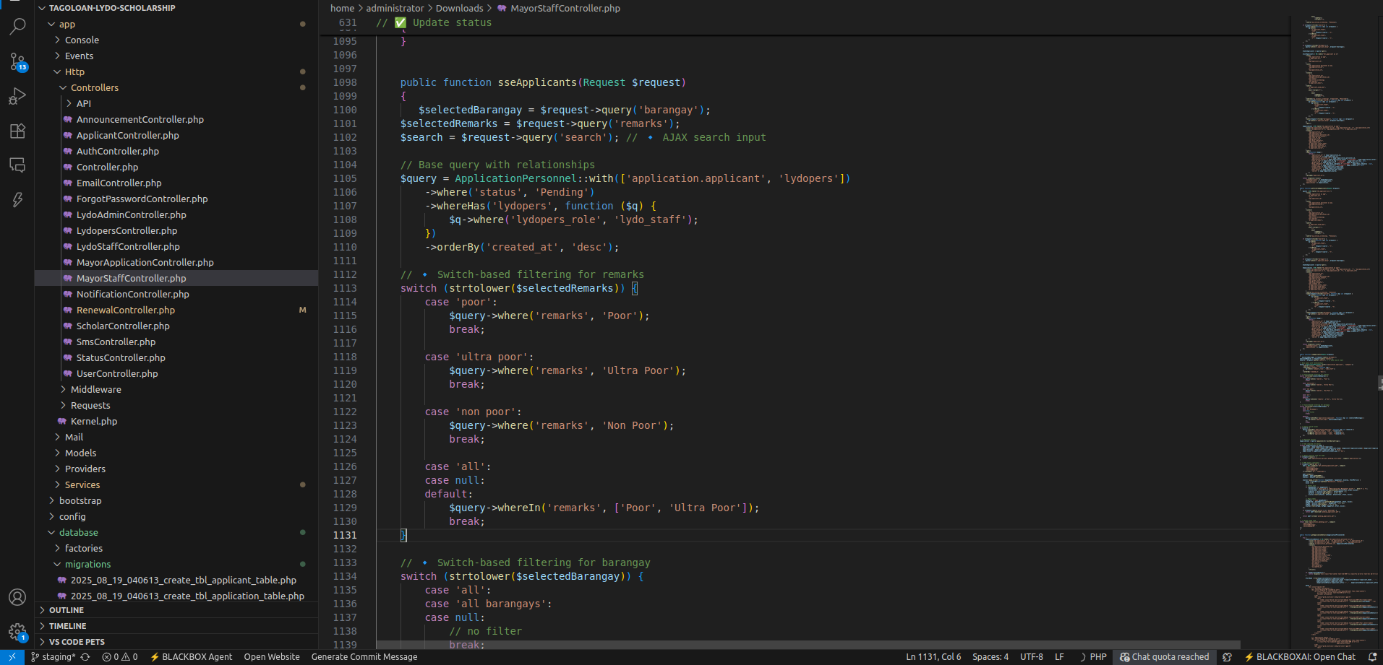
Problem 2: The N+1 Killer (Eager Loading Issue)
DIAGNOSIS :
1 query to load the main personnel record
1 extra query to get the application record
1 extra query to get the applicant information
FOR N ROW, THIS BECOMES
1 ( main query ) + 2N extra - queries
DEBUGBAR SHOW REPEATED SIMILAR QUERIES PER REQUEST :
select * from tbl_application where id=?
select * from tbl_applicant where id=?

Slide 7

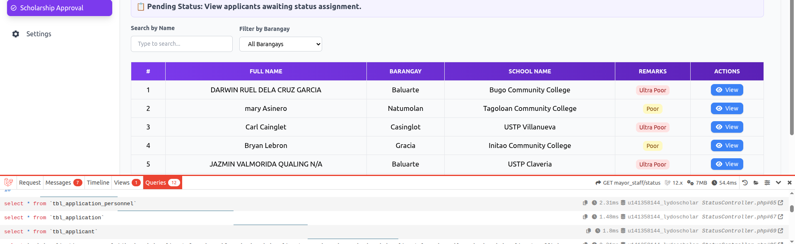
Problem 2: The N+1 Killer ON SCHOLARSHIP APPROVAL PAGE
RESULT AFTER EAGER LOADING :
applicant list
schools with ID IN (...)
barangays with ID IN (...)

Slide 8

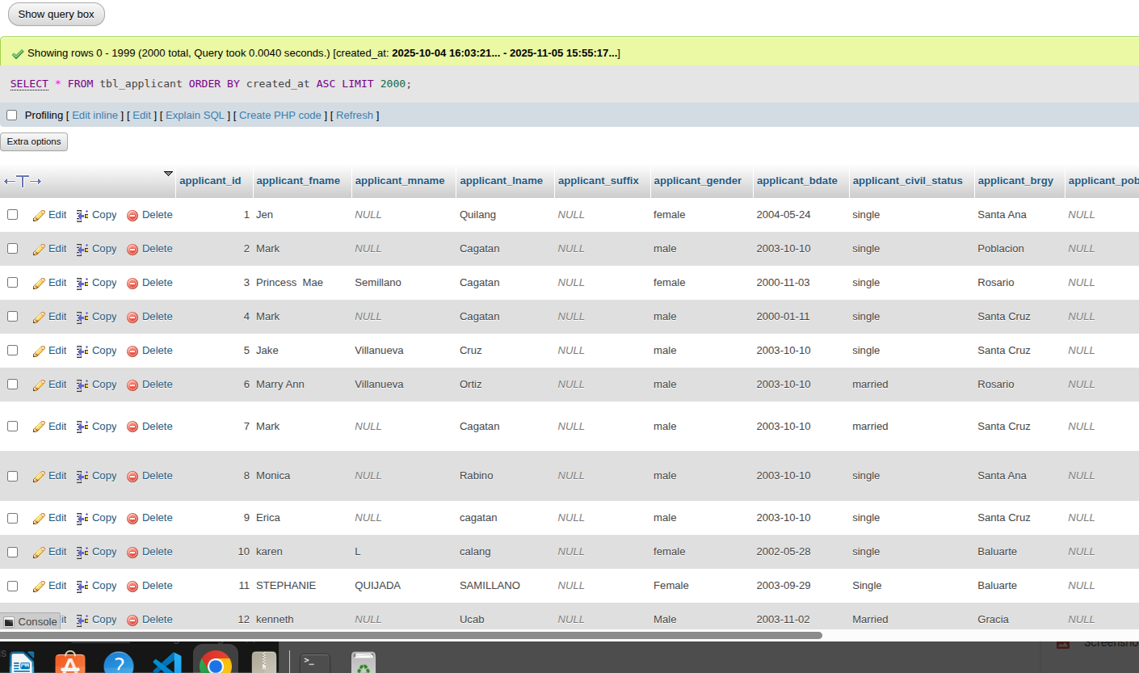
Problem 3: The Design or Turning Flaw
LOCATION :
admin applicant list (tbl_applicant)
EVEN THOUGH DATA LOADS SUCCESSFULLY, THE QUESRY DESIGN HAD INEFFICIENCIES
used select * ( loads all columns )
retrieved 2000 rows at one using LIMIT 2000 ( deep paging ).
GOAL :
to make the query faster and show only the important information.

Slide 9
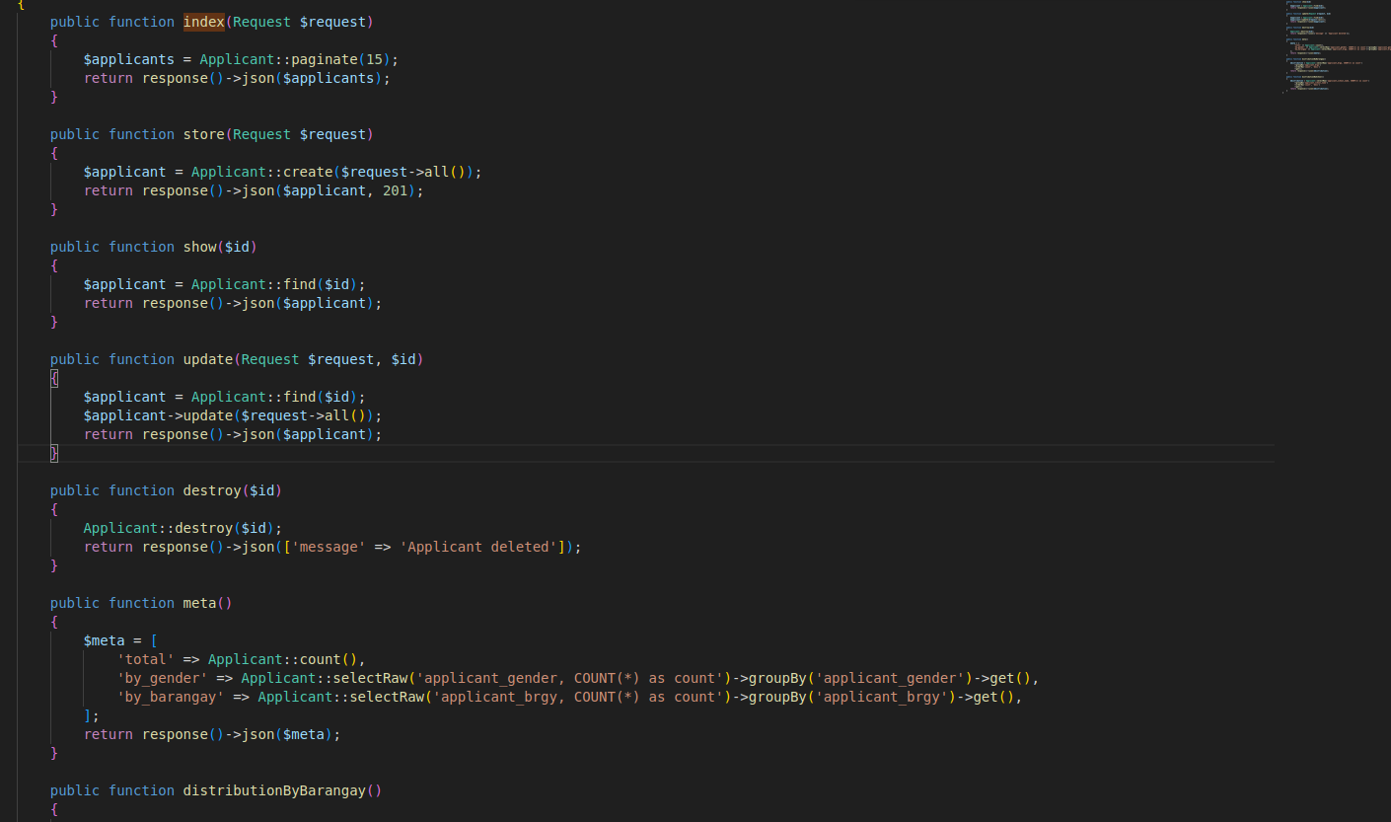

Problem 3: The Design or Turning Flaw
OLD CODE
SELECT * gets all columns, even those not shown in the UI.
$request->all() saves all inputs without checking.
Pagination loads 15 full records instead of needed fields only.
Too much data makes the system slower.

Slide 10

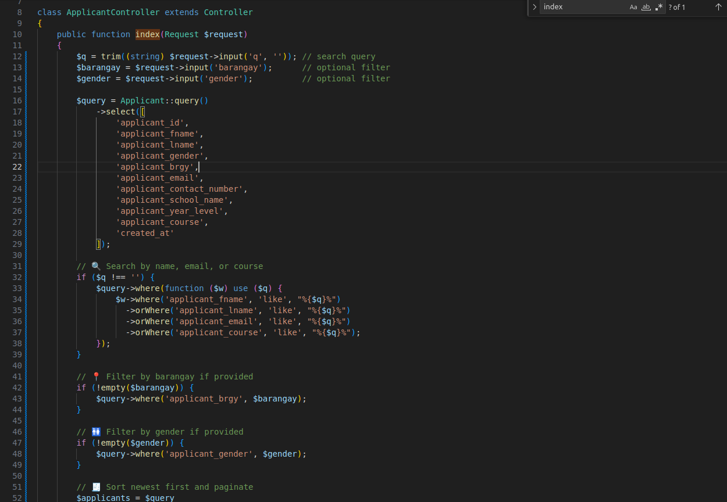
Problem 3: The Design or Turning Flaw
Switched from SELECT * to specific columns.
Keeps filters (search, barangay, gender).
Uses pagination (10/25/50 per page) to avoid deep paging.
Reduces data load and memory use, improving performance.

Slide 11
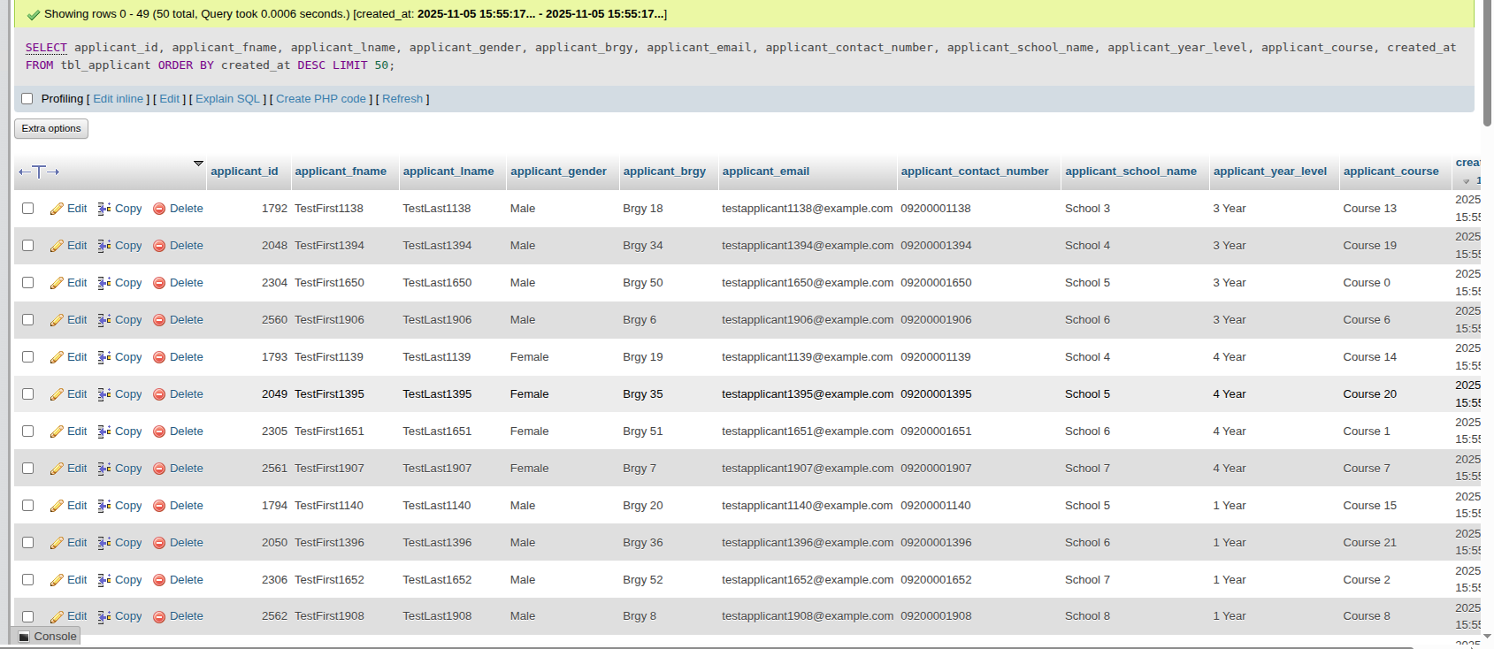

Problem 3: The Design or Turning Flaw
Result in MySQL:
Query now returns only 11 specific columns instead of the entire row.
Uses a reasonable LIMIT 50 for faster loading and easy pagination.
Benefits:
Less data read from tbl_applicant.
Less data sent from MySQL → PHP → browser.
Avoids showing unnecessary or sensitive information.
Query time is shorter and performance scales better with more records.

Slide 12
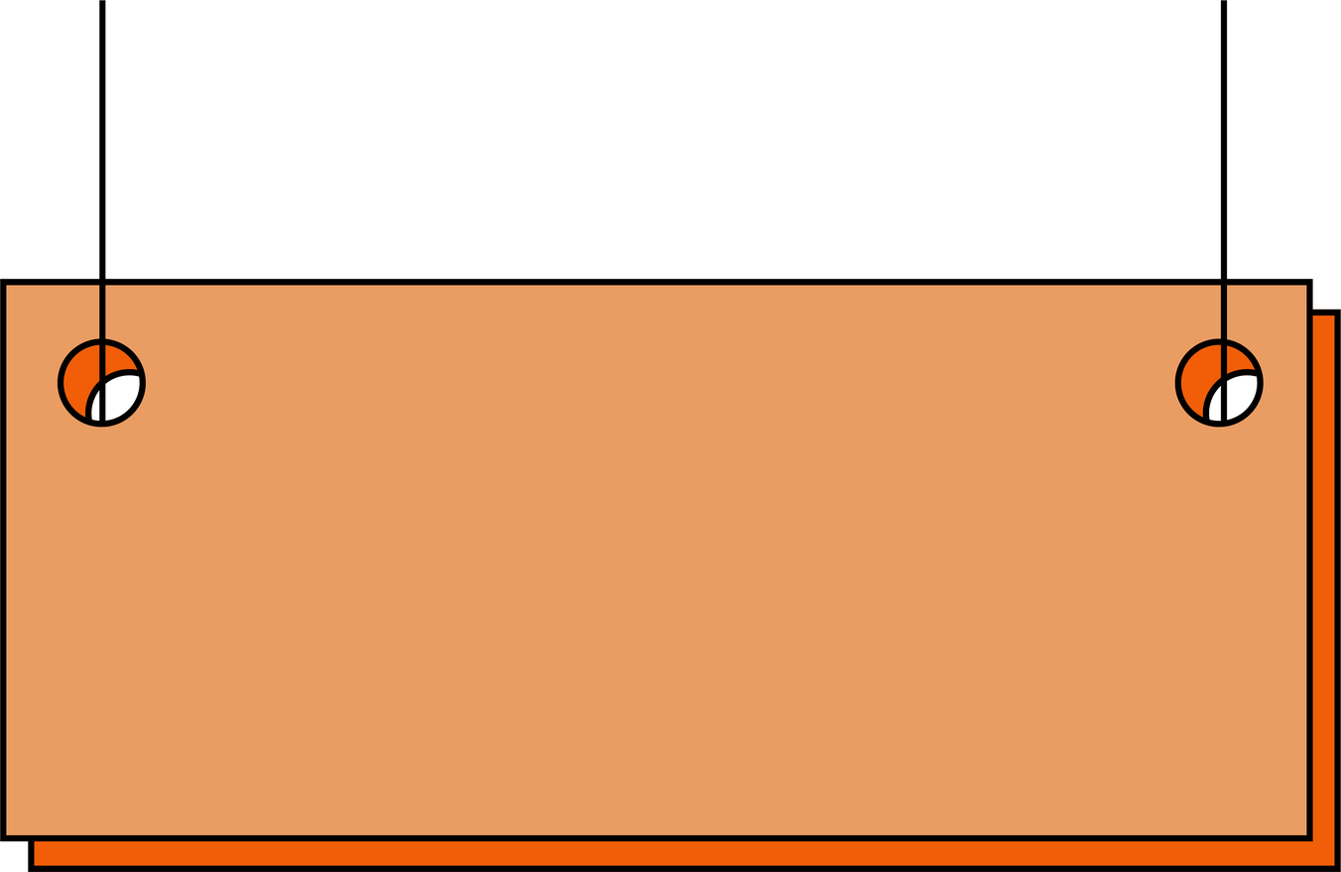

Data Optimization
PROBLEM 1 : SLOW QUERY ON TBL_APPLICANT
Added index on created_at and brgy to make loading faster.
PROBLEM 2 : N+1 QUERIES ON APPLICANT LIST PAGE
Used eager loading with with(['barangay', 'school']) to batch queries and reduce load time.
PROBLEM 3 : DESIGN FLAW ON APPLICANT RECORDS
Selected only needed 11 columns and limited it to 50 rows for faster and lighter results.

Slide 13

TEAM PRACS
Joanna Marie Arias
Mark Cagatan
Jose Allan Jimeniz
Leah Palmones
Monica Rabino
Stephanie Samillano

